Slide 1
Data Analysis project
Loan dataset analysis:
How does loan/debt impact population demographics base on personal parameters.
Group 8
Ziyue Zhou(Jacky)
Sher Wang
Riwas Karki
Jordan Chia

Slide 2

Introduction:
- Growing number of people in financial stress amid rise in loan defaults.
Findings and insights through programming:
What are people’s loans mainly for? - JC
How does employment duration impact loan approval rate? -JC
Is there any relationship between loan amount and people’s income? - Jacky
Does homeownership affect the loan grades? – Jacky
Is there any relationship between the term of years and loan status? - Sher
How does income affect loan repayment? - Sher
What is the main intent for the loan? -RK
What are the correlations between different attributes? -RK
What are the impacts of historical loan defaults on current loan status? -Sher
Conclusion:
- What we learned from the analysis of the loan/debt and people’s lives.

Slide 3
Introduction
The dataset contains information about the customer loans along with the customer demographics and default status taken in the UK.
The findings includes several graphs, plots and charts along with the hypothesis testing to support the answers.
steps for approaching this EDA project:
download the raw CSV file, create Jupyter Notebook loading data frame, access and examine the data, perform cleansing, subsetting, and reframing,
conduct a series of statistical tests to understand the data, plotting and then finalizing the written analysis about the question.

Slide 4

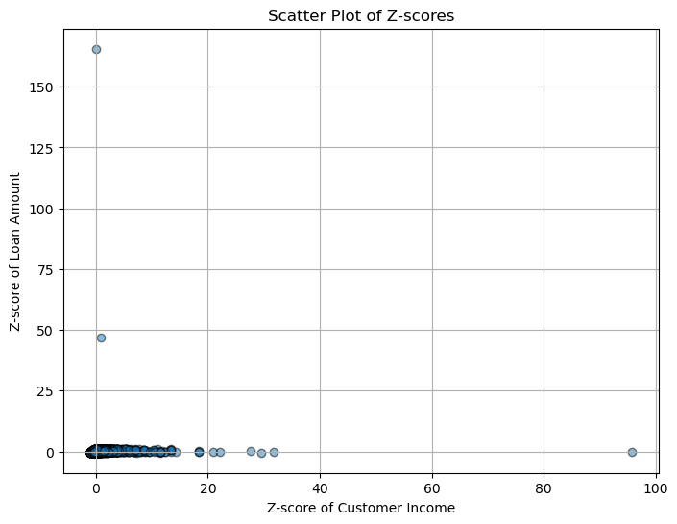
The data distribution calculated form the Z-score plotting.
Findings:
It contains extreme values that significantly affects the analysis.
Most income & loan distributed in lower boundaries that makes the data severely right skewed.
mean customer income :66074.73 median customer income: 55000.
mode customer income (mode=60000, count=1046)
mean loan amount: 9724.99
median loan amount 8000.0
mode loan amount (mode=10000, count=2664)
Variance (Var) of customer income :3842024514.77; Std: 61984.07.
variance (Var) of loan amount: 3842024514.77; Std: 21070.83.

Slide 5
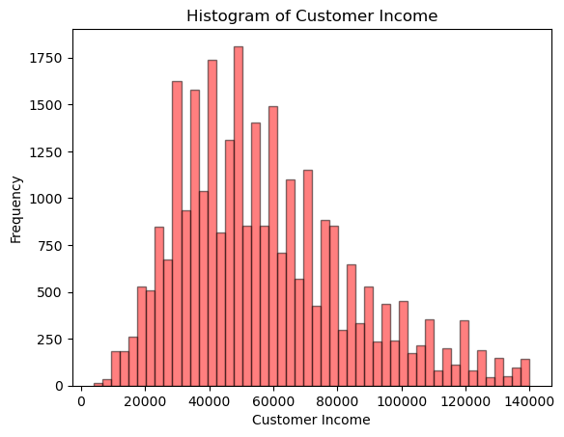
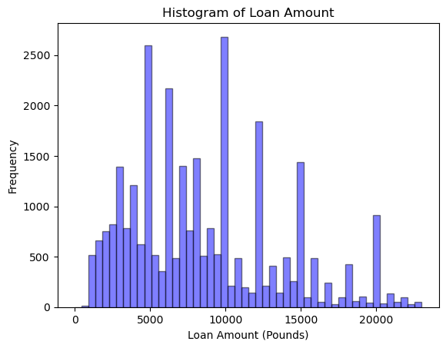
Histograms of income and loan amount respectively:
Findings:
For income, the most frequent value is between 40K and 60K.
For loan amount, the most frequent value appears between 5000 to 10K.

Slide 6
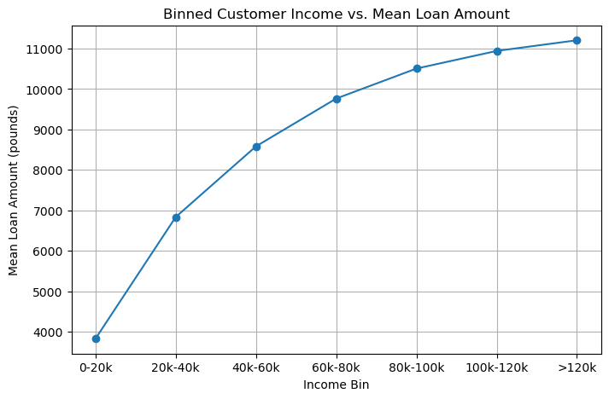
Binned income group with mean value of loan amount line graph:
Findings:
The more income people earned, the higher mean loan amount they can borrow.

Slide 7
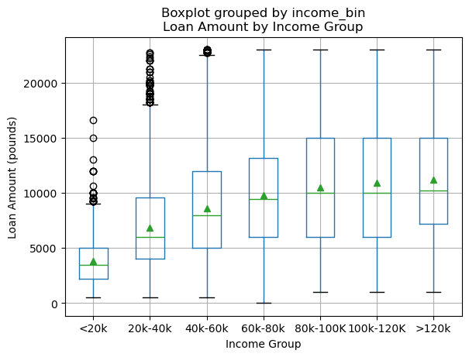
Boxplot of grouped income bin vs loan amount:
Findings:
The income group of between 20K to 40K has the most outliers, followed by income less than 20K
Which indicates despite the income level, people still can borrow loan more than the calculated boundaries.

Slide 8
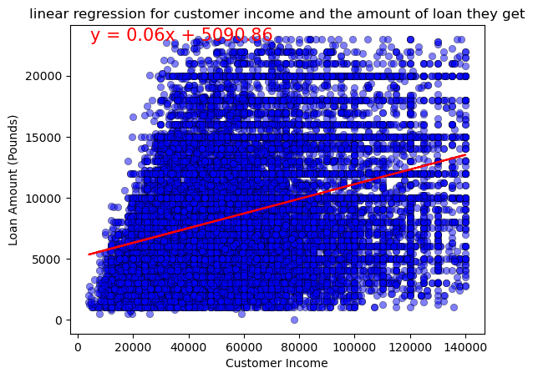
Linear regression plot for income vs loan amount:
Findings:
Positive correlation from to the slope and y-intercept.
Clearly, we can see there is some relationships between income and loan amount. As income increase, loan amount can increase as well.
Hence, we can successfully reject the null hypothesis (H0), and accept the H1 that loan amount is impacted by incomes.
Pearson Correlation: 0.3275049; P-value: 0.0
The R-squared value is 0.11.
T-statistic: 308.55952, P-value: 0.0

Slide 9
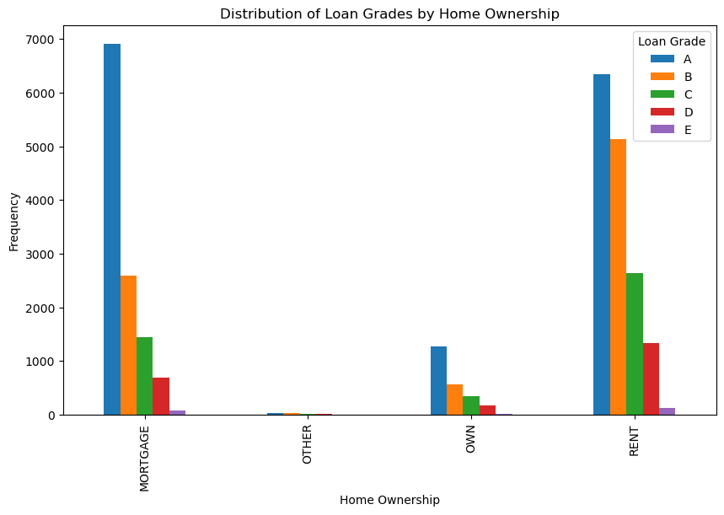
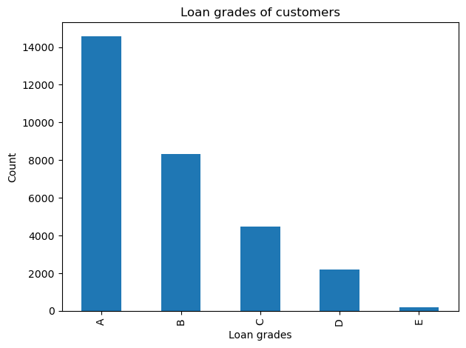
Bar graph for loan grades count and grouped bar graph frequency chart:
Findings:
Mostly A grades, in mortgage and rent ownership there are most A grades loans.
Surprisingly, not the owned home has the most A grade.
We can see homeownership does impact the loan grading in a positive way, (more higher loan grade you will be)
Hence, we can reject the null hypothesis(H0) and accept H1 that home ownership is correlated with the loan grades.
Chi-Square contingency: 946.0920878;
P-value: 7.221946078059247e-195.

Slide 10
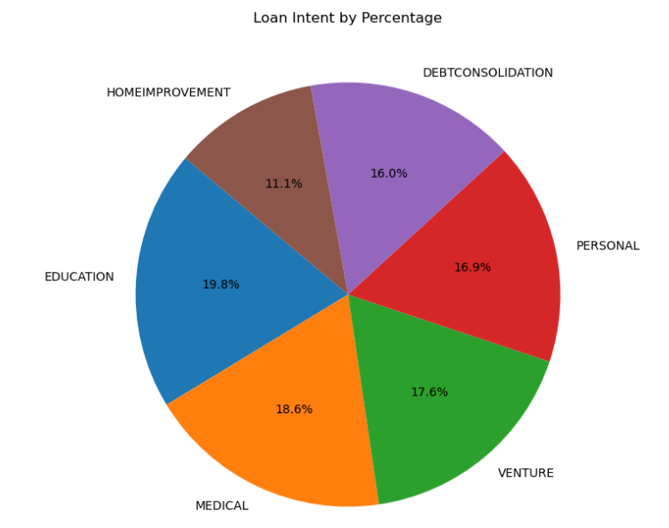
The pi-chart shows the distribution of loan intent by percentage.

Slide 11
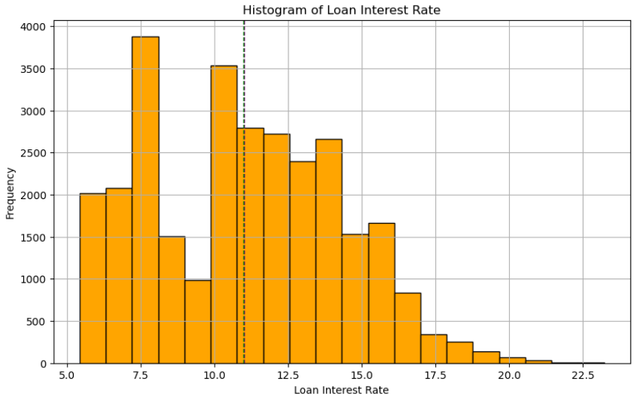
Histogram for the interest rate frequency.
Mean and median are very close.

Slide 12
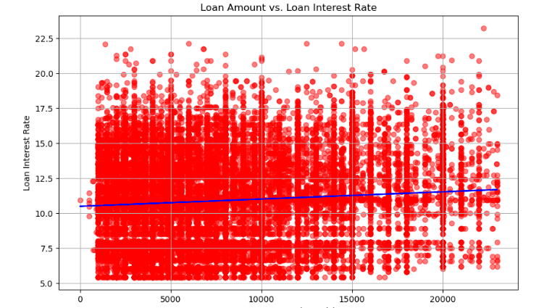
Relation between Loan amount and interest rate.
There is a linear positive relation between the 2 attributes.
Interest rate seems to increase slightly as the loan amount increases.

Slide 13
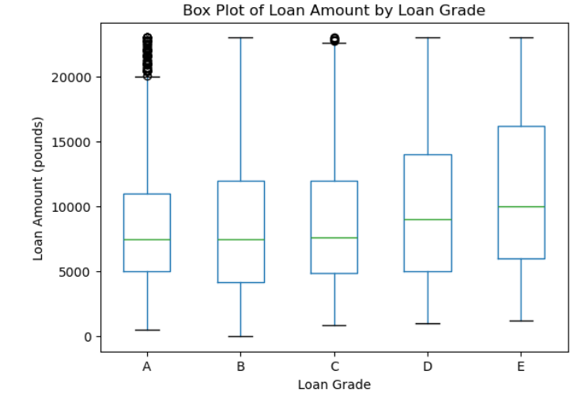
Box plot of loan amount by grade.
The plot suggests there is no significant change in the loan grade for amount in range 7 to 8 K. Buy after 8 k the grade starts to fall as the mean is higher for D and E grades.

Slide 14
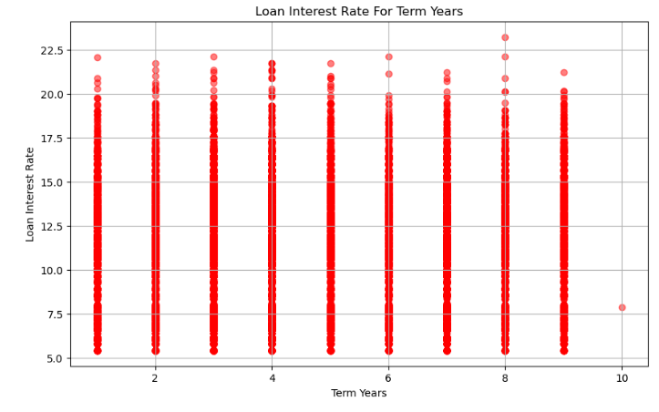
Interest rate for the term year.

Slide 15
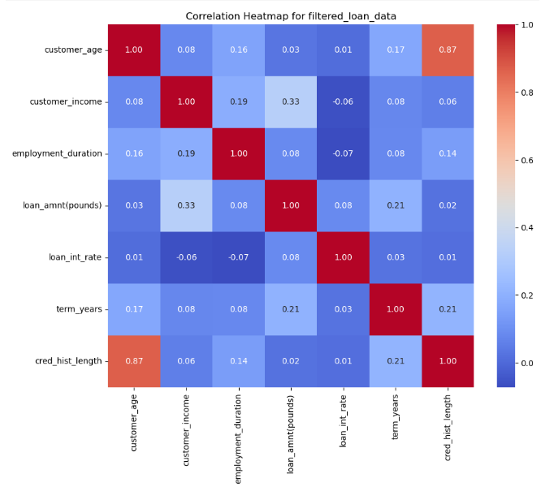
Correlation Heatmap.

Slide 16
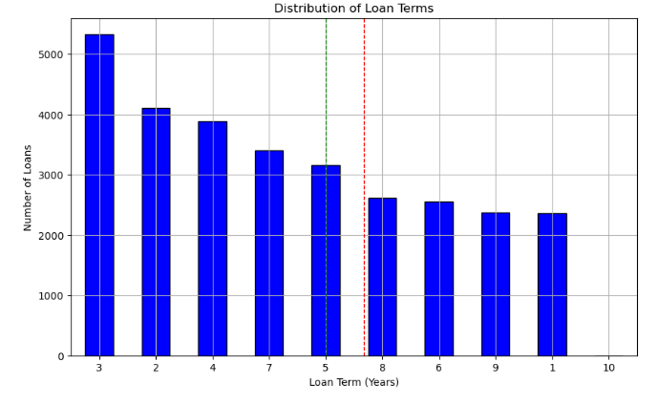
Loan term distribution across the year
The graph suggests that the most common loan term is 3 years.
There are very few customers with a loan term of 10 years.
Mean: 7
Median: 5

Slide 17
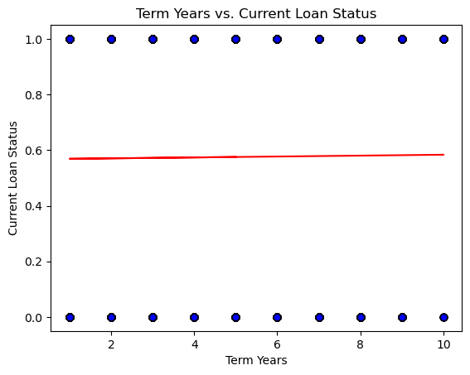
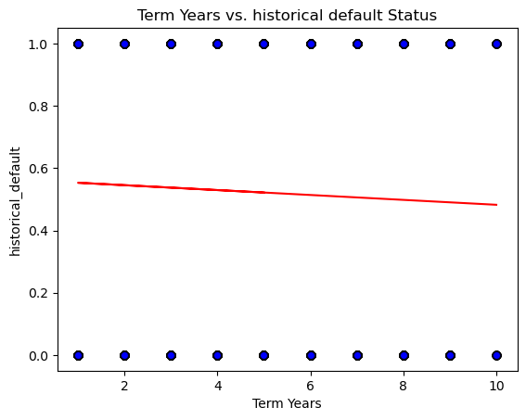
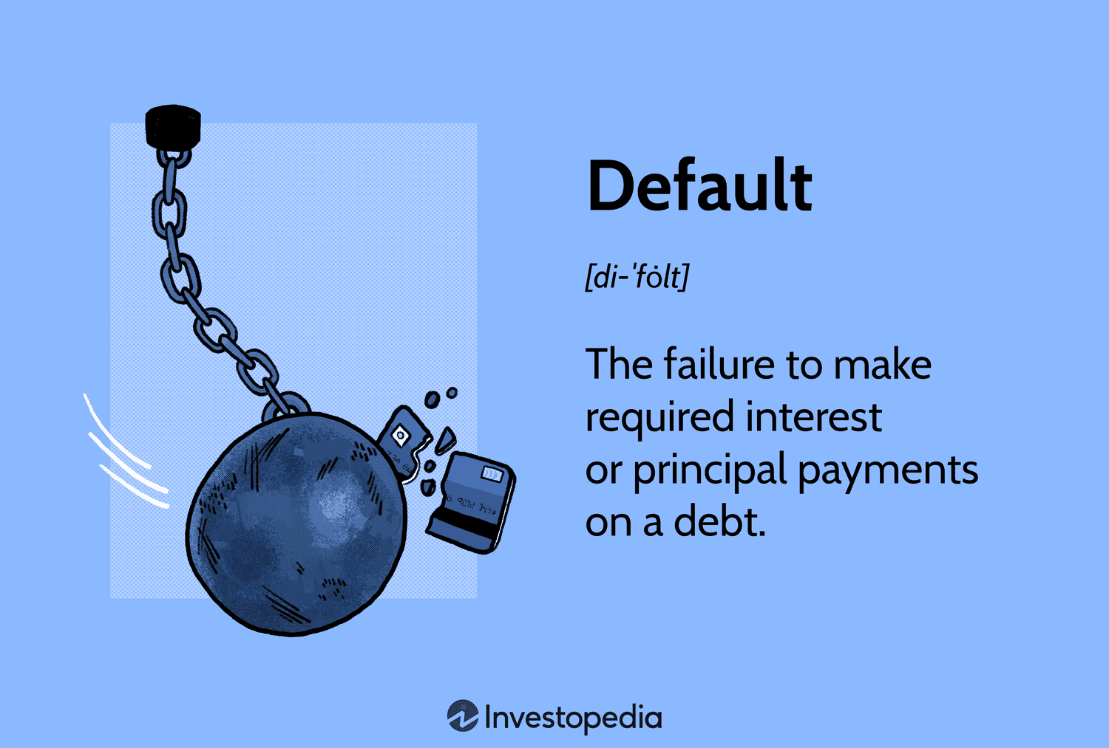
Term Years vs. Current Loan Status
Term years &
default status
correlations
R squared: 0.000
Term Years vs. Historical Default Status
R squared: 0.002

Slide 18
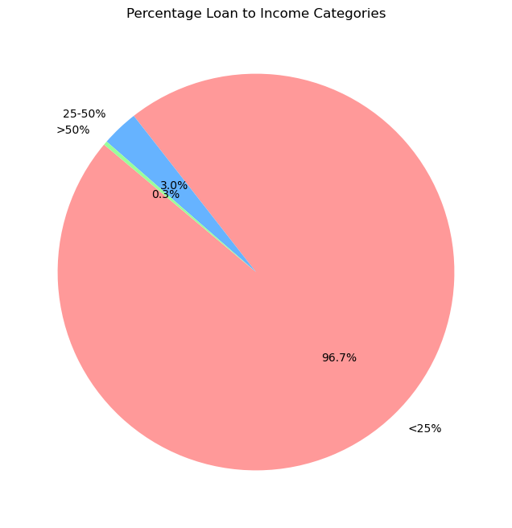
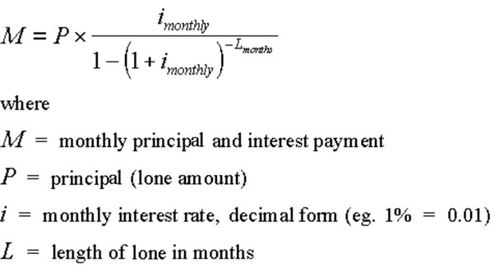
Loan percentage to customer income
96.7% of customers have their loan taken up <25% of their income while there are 3.3% of customers have loans over 25% of their total income percentage.

Slide 19
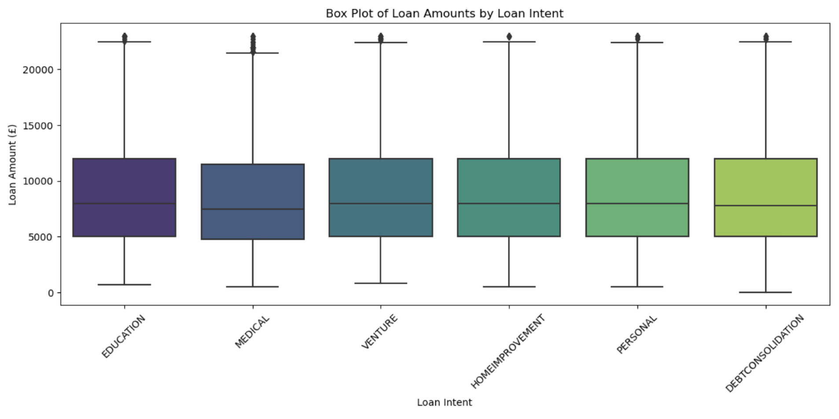
Loan Amount Vs Loan Intent
Compare loan amount distribution for each loan intent category

Slide 20
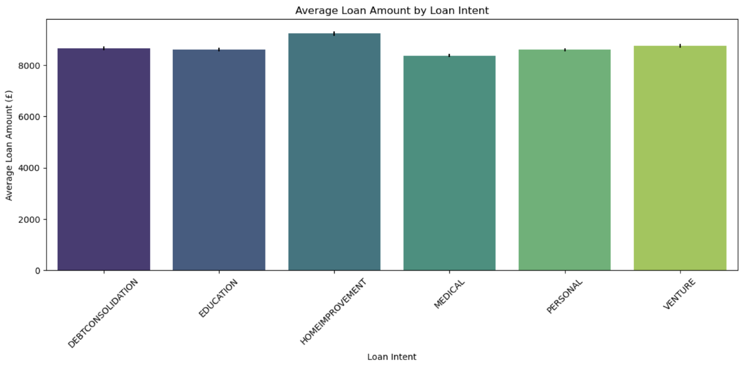
Loan Amount Vs Loan Intent
Compare average loan amounts across the loan intent.
Analysis of Variance Results
F-statistics = 13.45978744992072
P-value = 3.861858024511215e-13

Slide 21
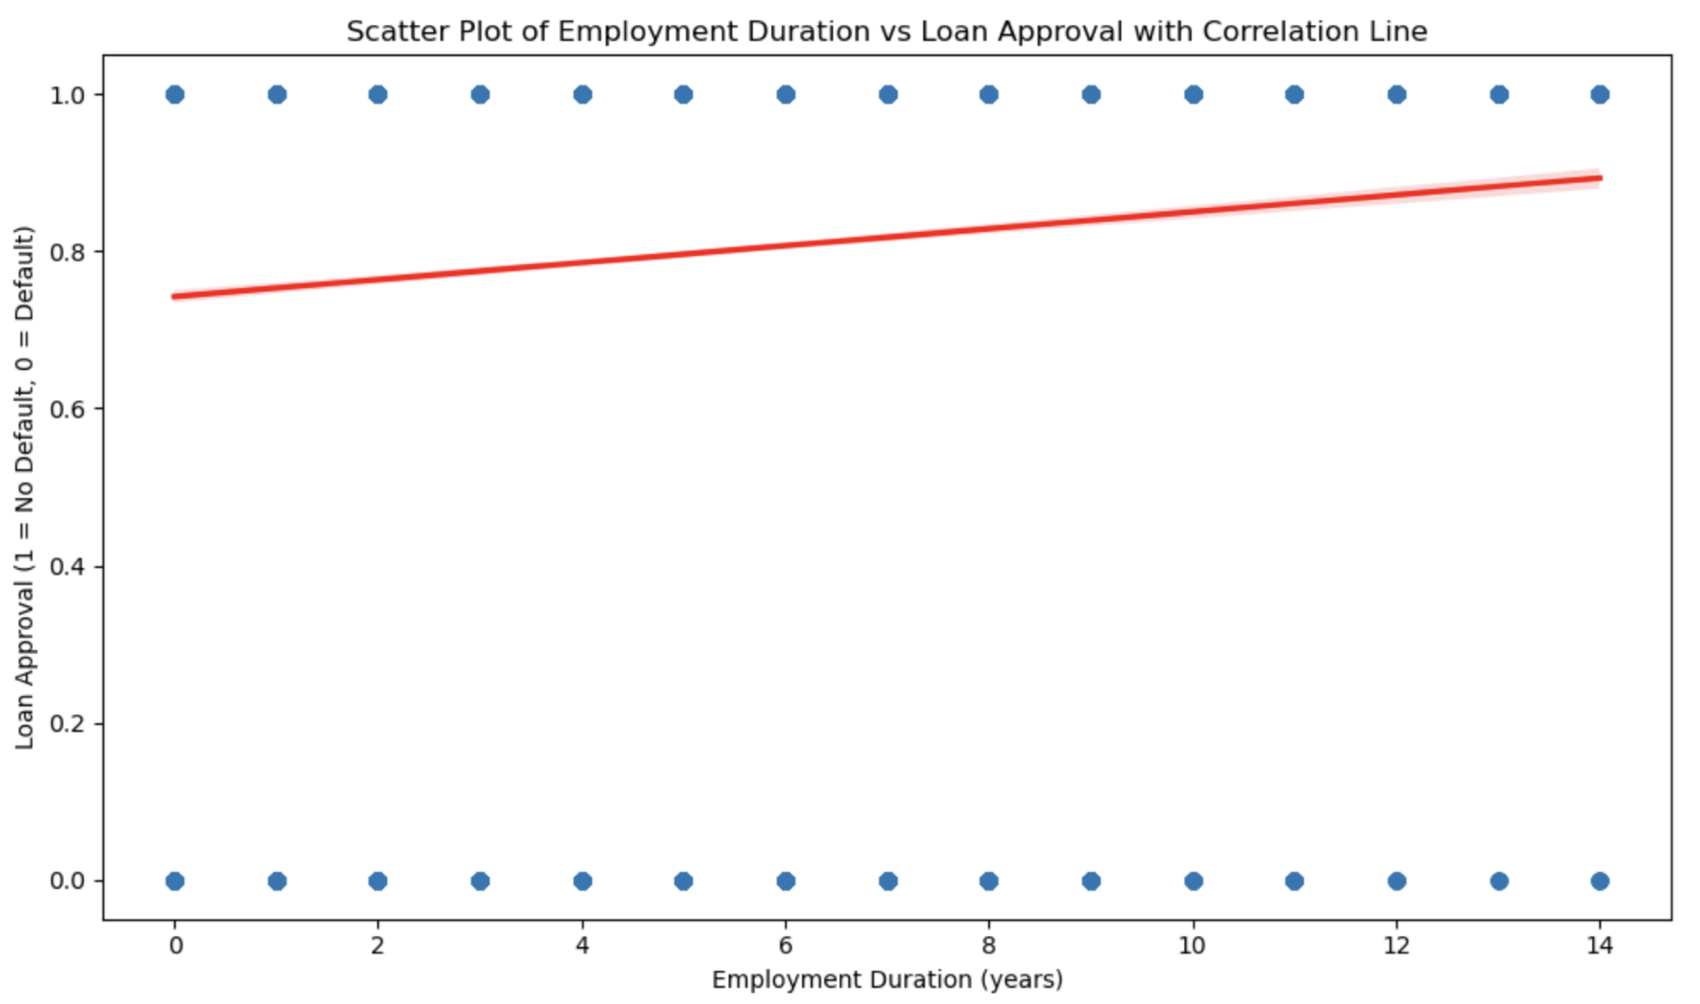
How Years of Employment Influence Loan Approval
Correlation between employment duration and loan approval = 0.09120912049623413
Positive correlation coefficient indicate positive relationship between employment duration and loan approval

Slide 22
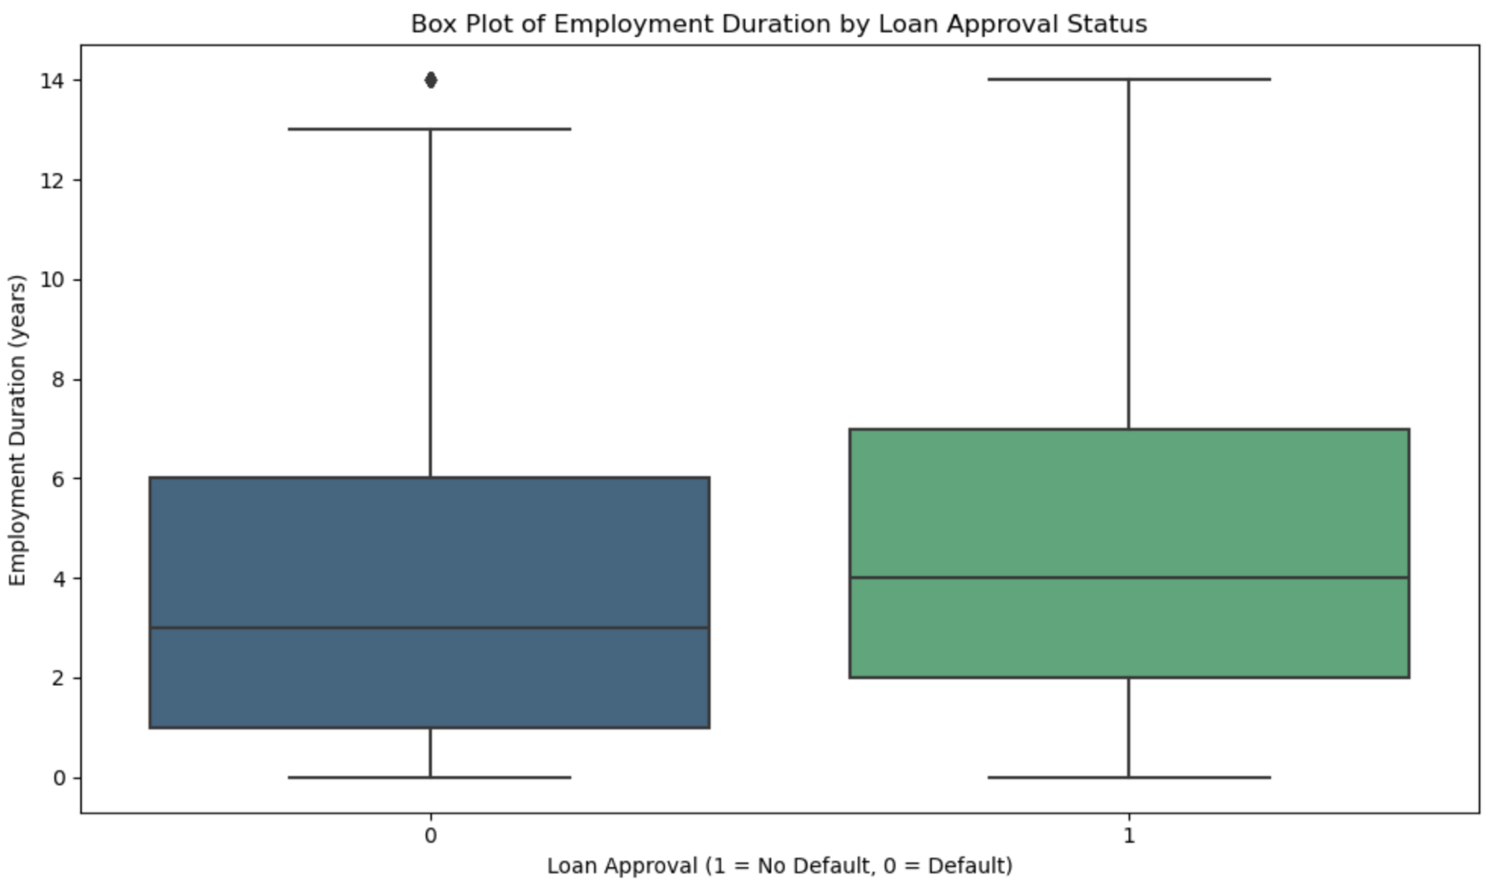
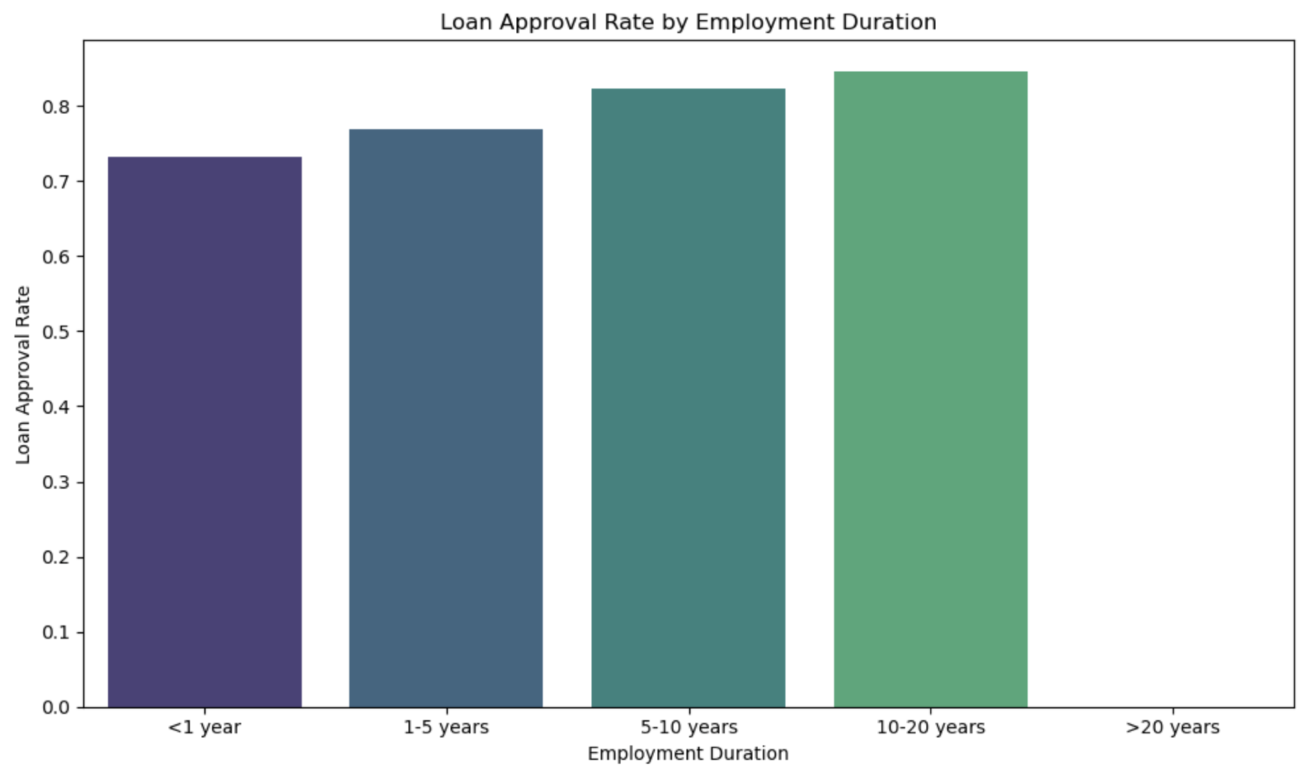
How Years of Employment Influence Loan Approval

Slide 23

Conclusion
Term years have a minor correlation with loan status, indicating they do not significantly impact repayment failures.
Higher incomes correlate with larger loan amounts, but income alone is not the sole determining factor.
Homeownership affects loan grading, though other factors also play a role.
Interest rates rise with increasing loan amounts.
Higher incomes are associated with larger loan amounts and fewer defaults.
Longer employment duration is linked to higher loan approval rates, supported by scatter plots, correlation analysis, and logistic regression, providing valuable insights for assessing creditworthiness.
Visualizations and statistical tests reveal significant patterns in loan amounts across different purposes, aiding lenders in decision-making.

Slide 24
References
Prakash Raushan, Loan-Dataset about the status of the loan based on different parameters, Kaggle.com, Licence: MIT, URL: https://www.kaggle.com/datasets/prakashraushan/loan-dataset
https://www.youtube.com/@AlexTheAnalyst
https://stackoverflow.com/questions/72475589/pandas-error-when-i-try-to-do-an-anova-test
https://stackoverflow.com/questions/40227773/using-logistic-regression-for-a-multiple-touch-response-model-python-pandas
https://www.youtube.com/@LukeBarousse
https://www.w3schools.com/python/numpy/numpy_random_seaborn.asp

Slide 25

Thankyou

